Slide 1

Algotrader
Trader Assistant Tool
One man Team : TAO
Notes:
Why need Trader assistant.
plan
work too hard

Slide 2
Purpose
As a day trader.
Before the market open: I want to predicate next day’s trend
Market hour: I want to monitor Realtime / catch best entry point
After entry: I want to best manage my trade

Slide 3
Before the market open

Slide 4
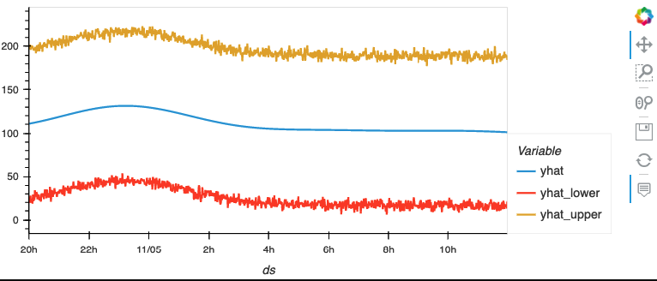
Prophet

Slide 5
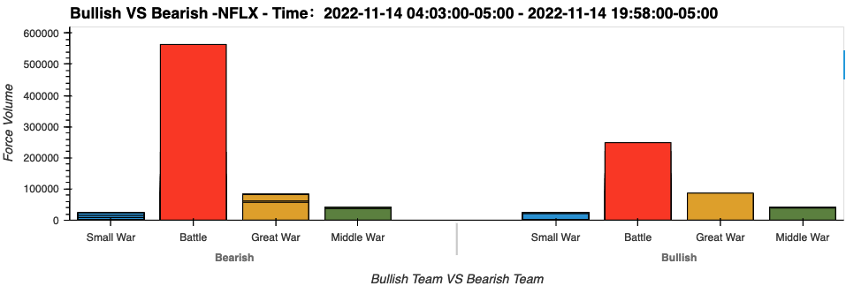
Bullish VS Bearish

Slide 6
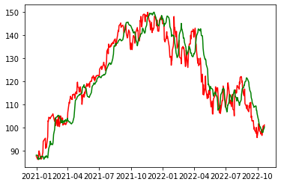
LSTM

Slide 7
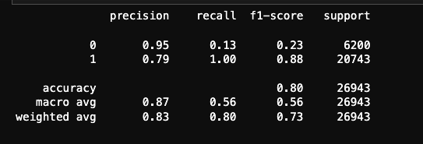
SVM

Slide 8
Market hour

Slide 9
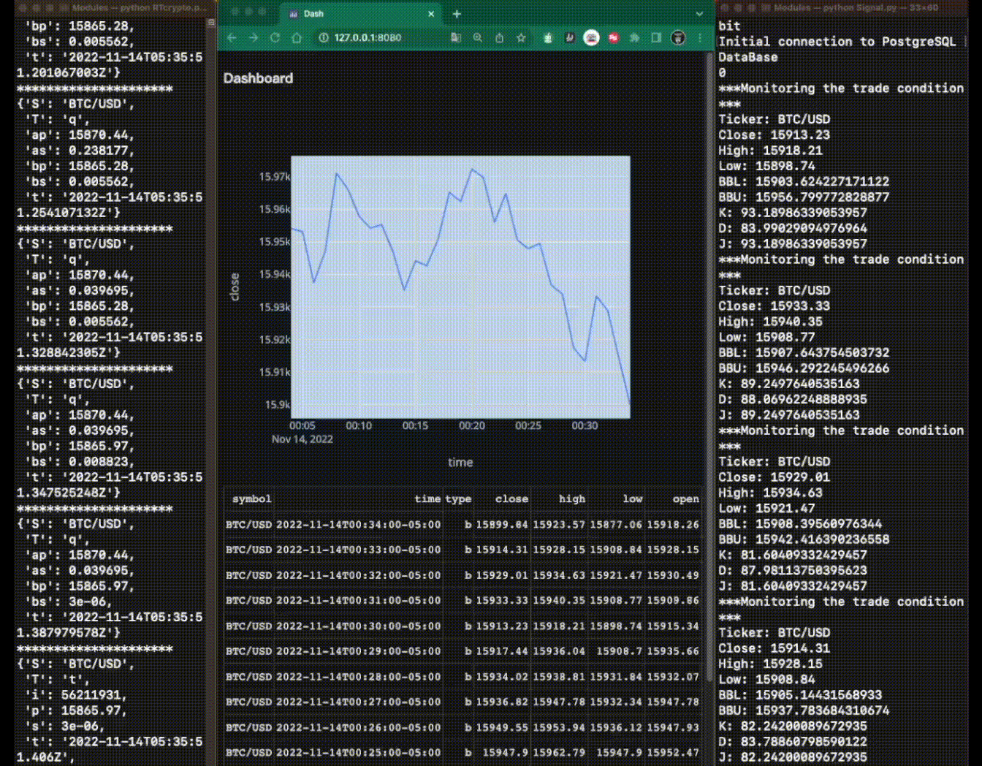

Slide 10
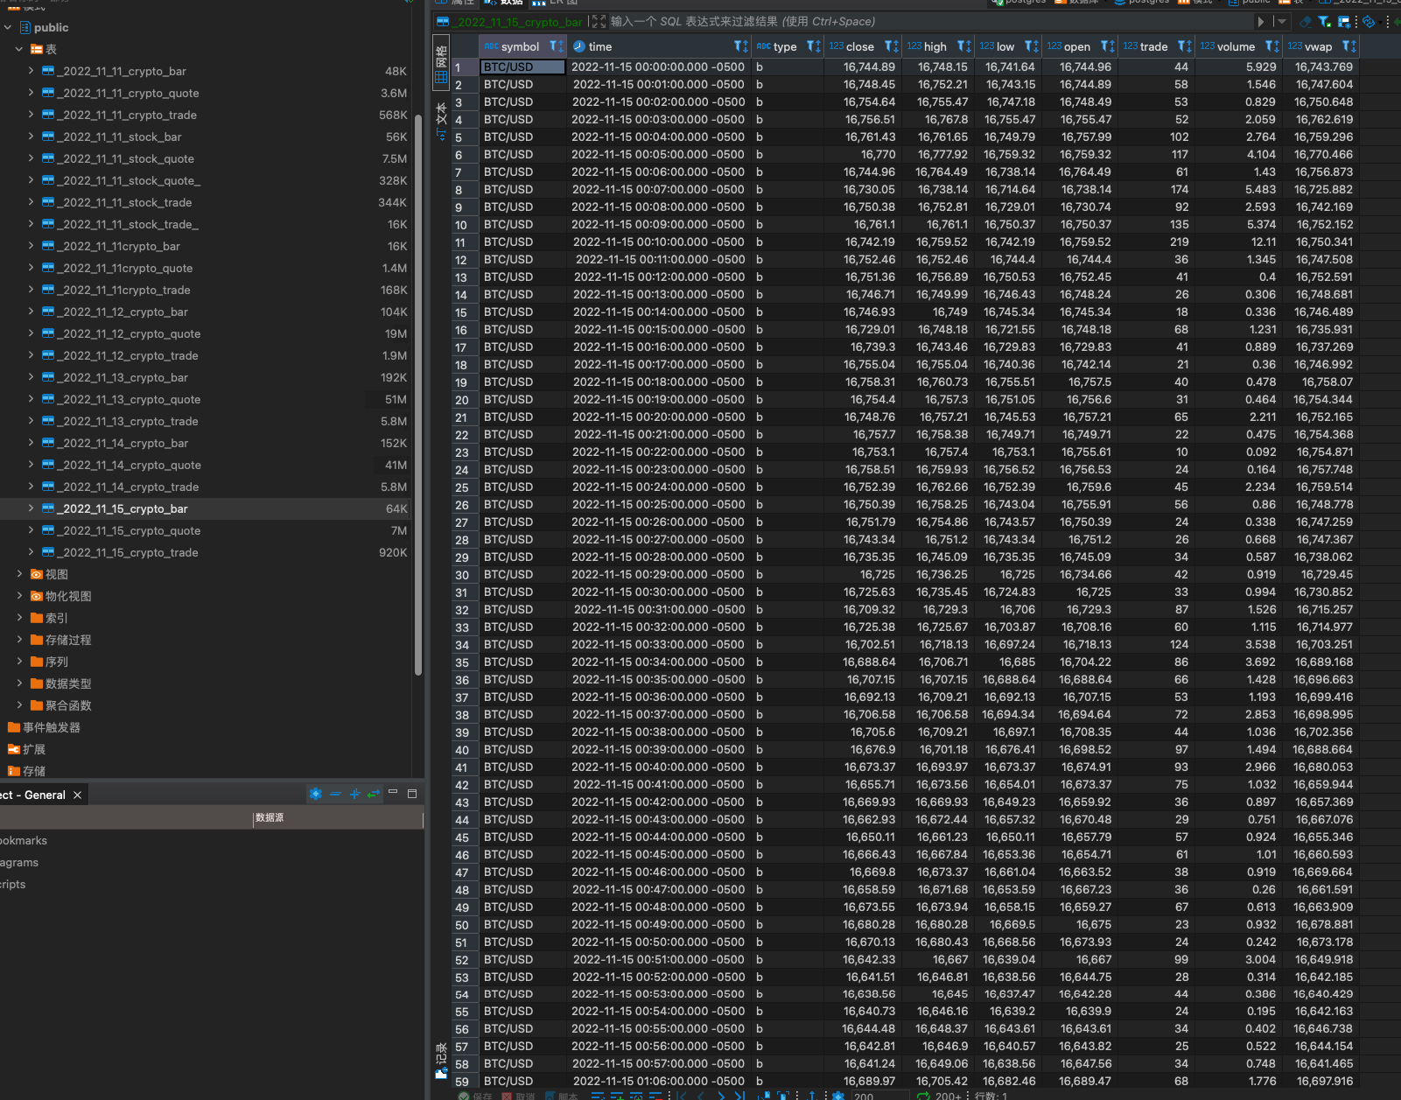

Slide 11
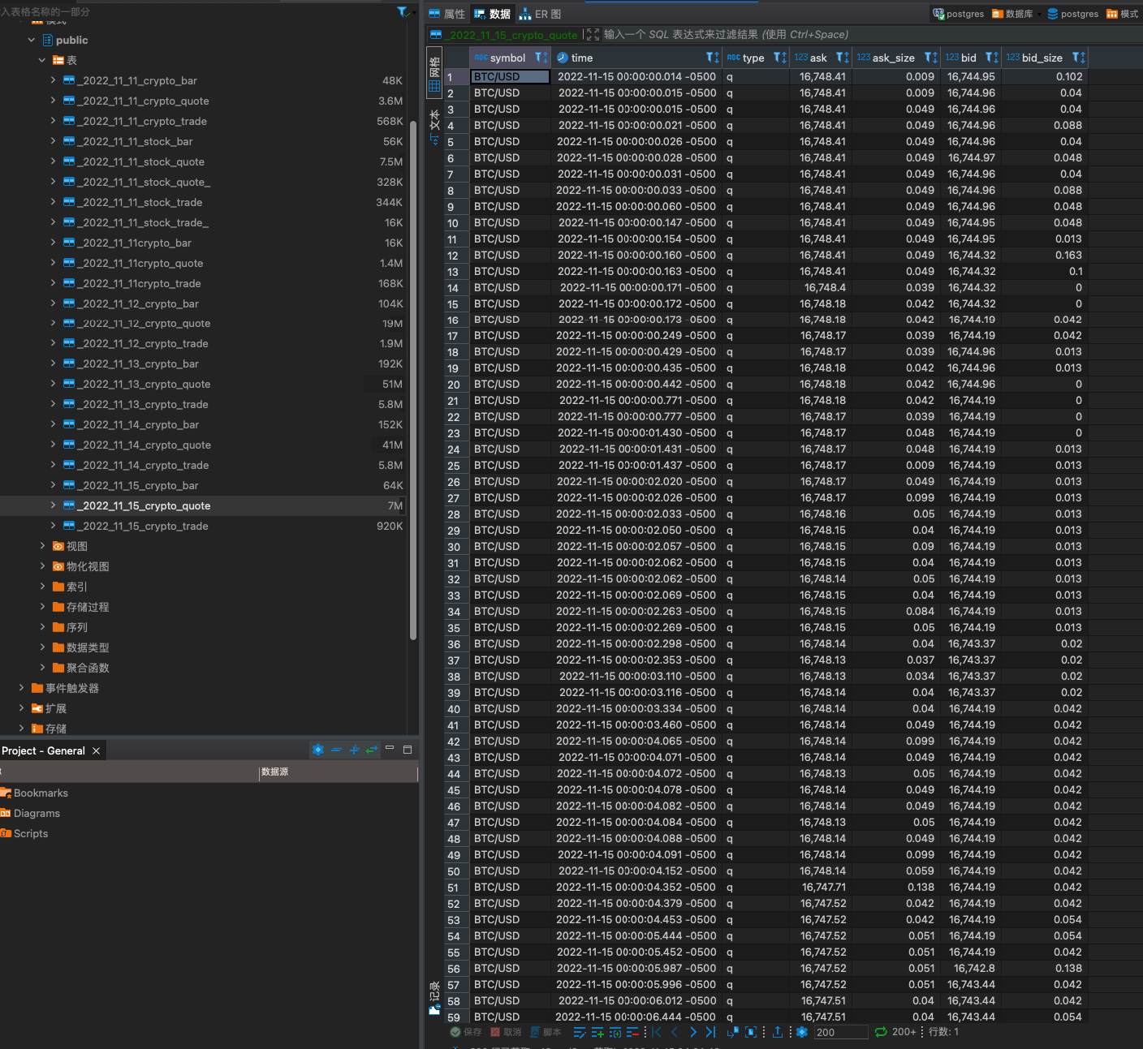

Slide 12
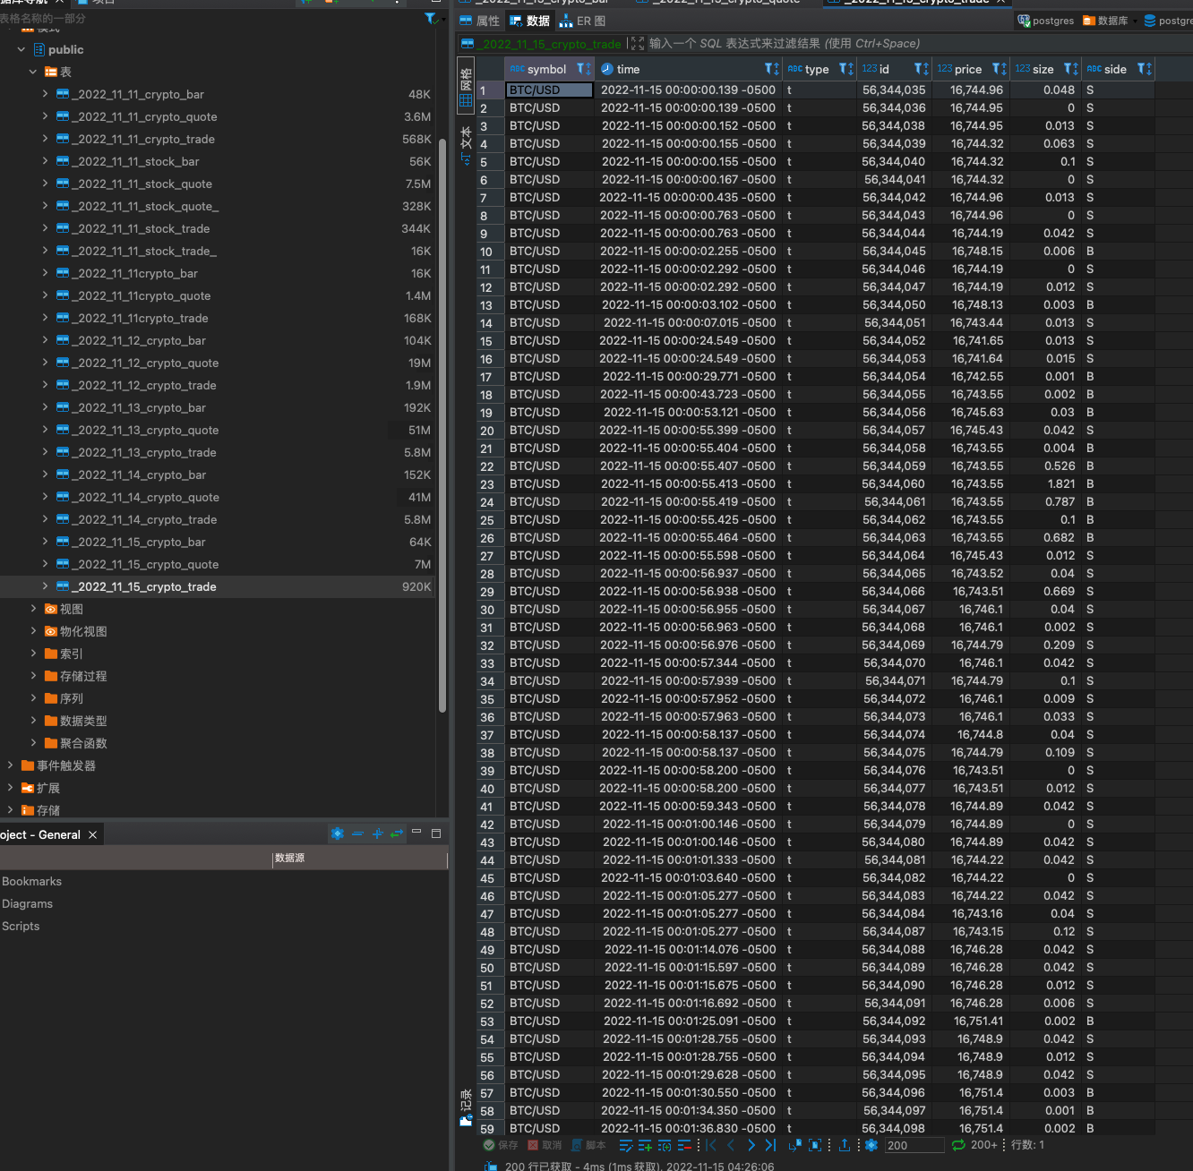

Slide 13
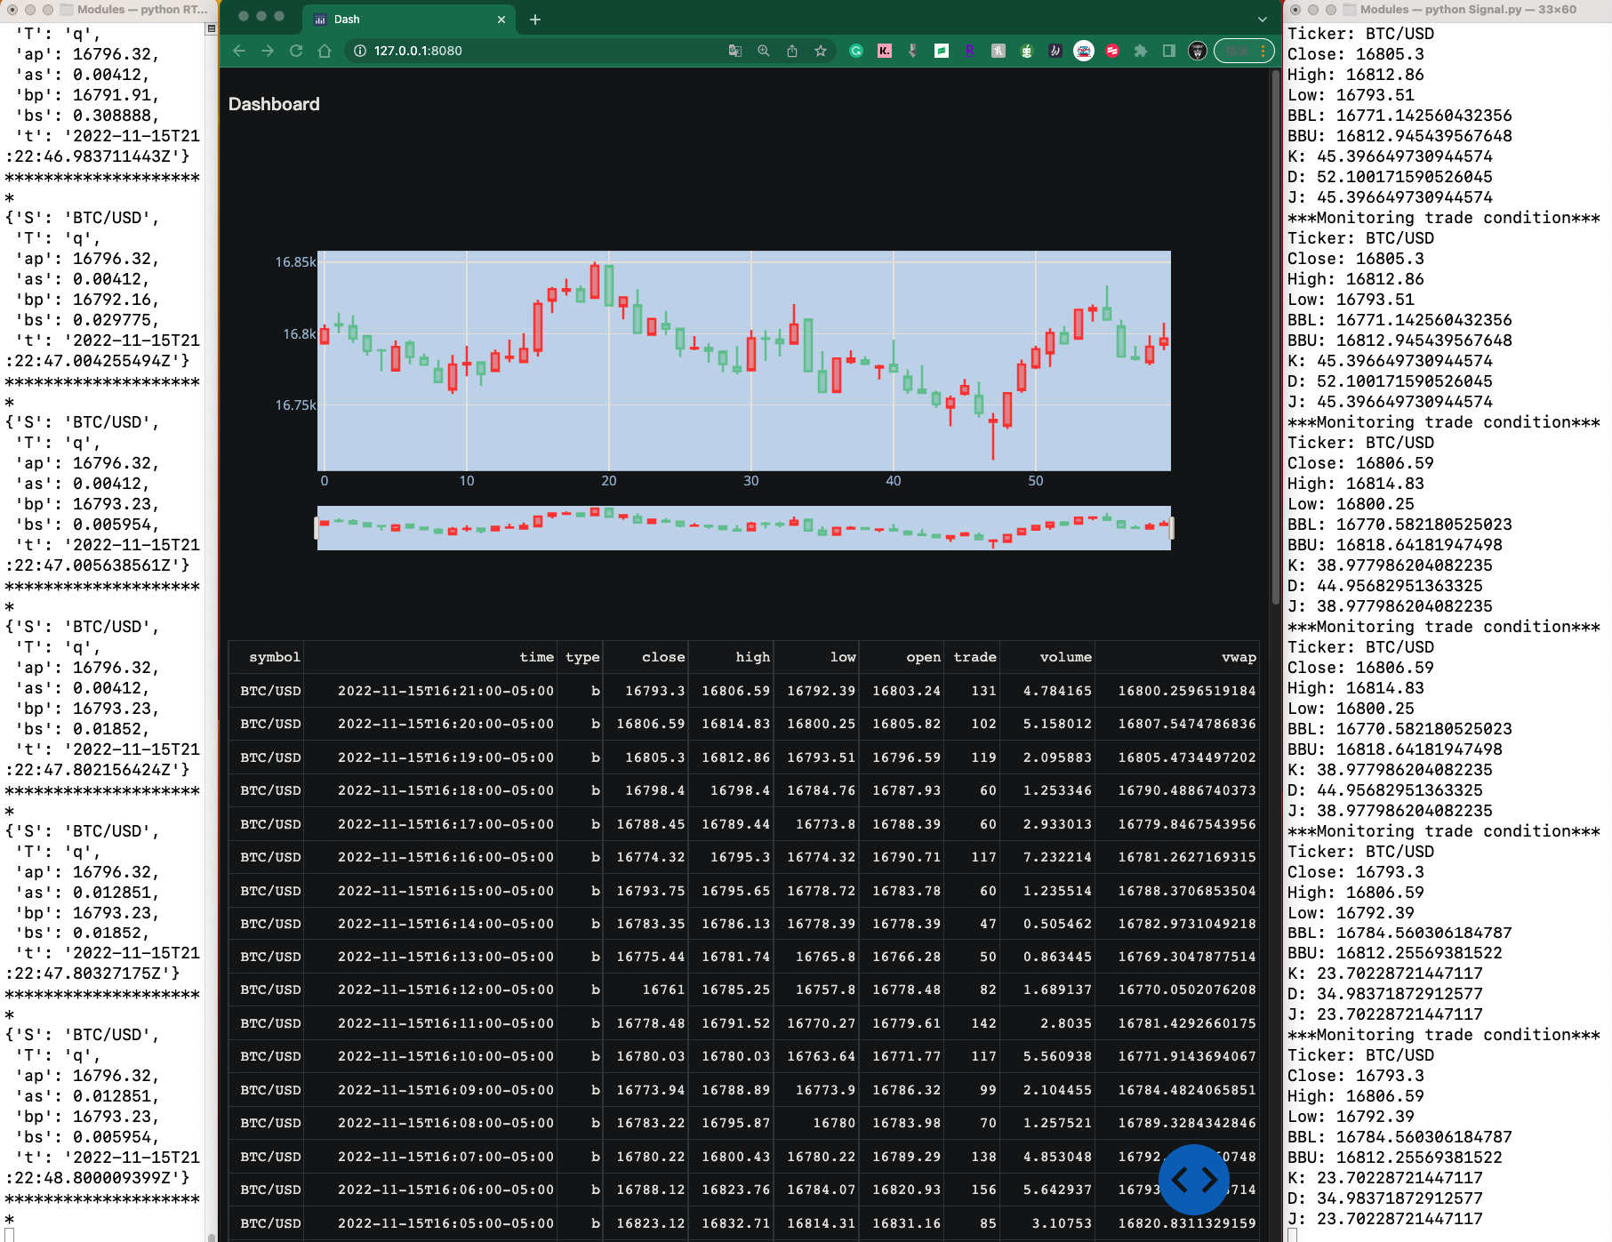

Slide 14
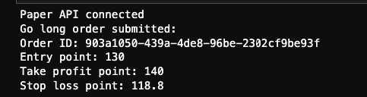
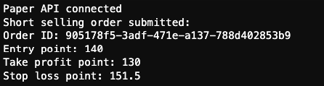

Slide 15
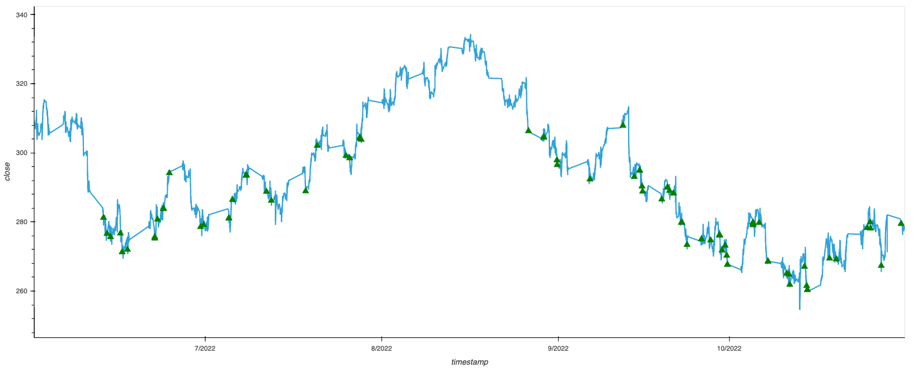
Backtest

Slide 16
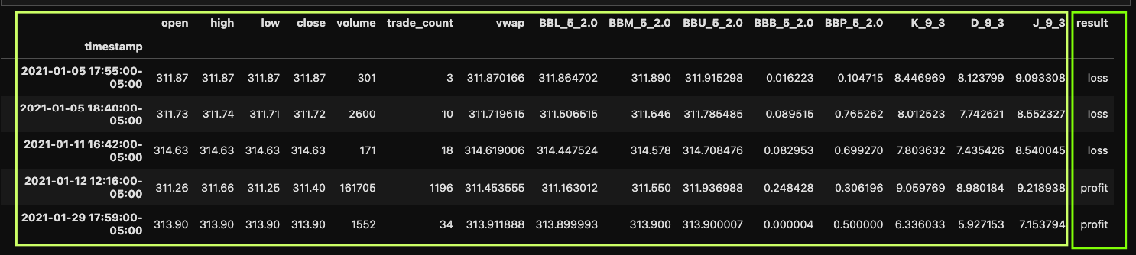
LogisticRegression

Slide 17
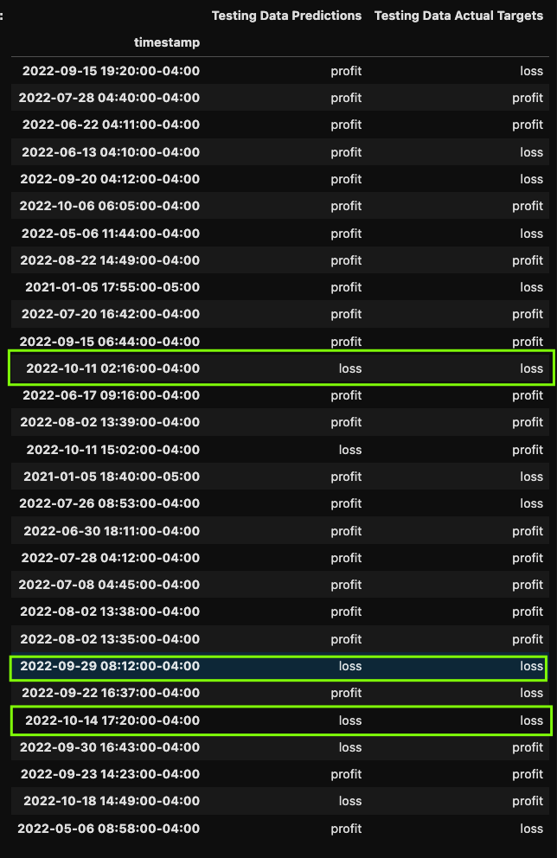

Slide 18
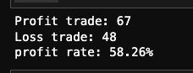
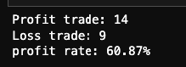
Before ML
After ML

Slide 19
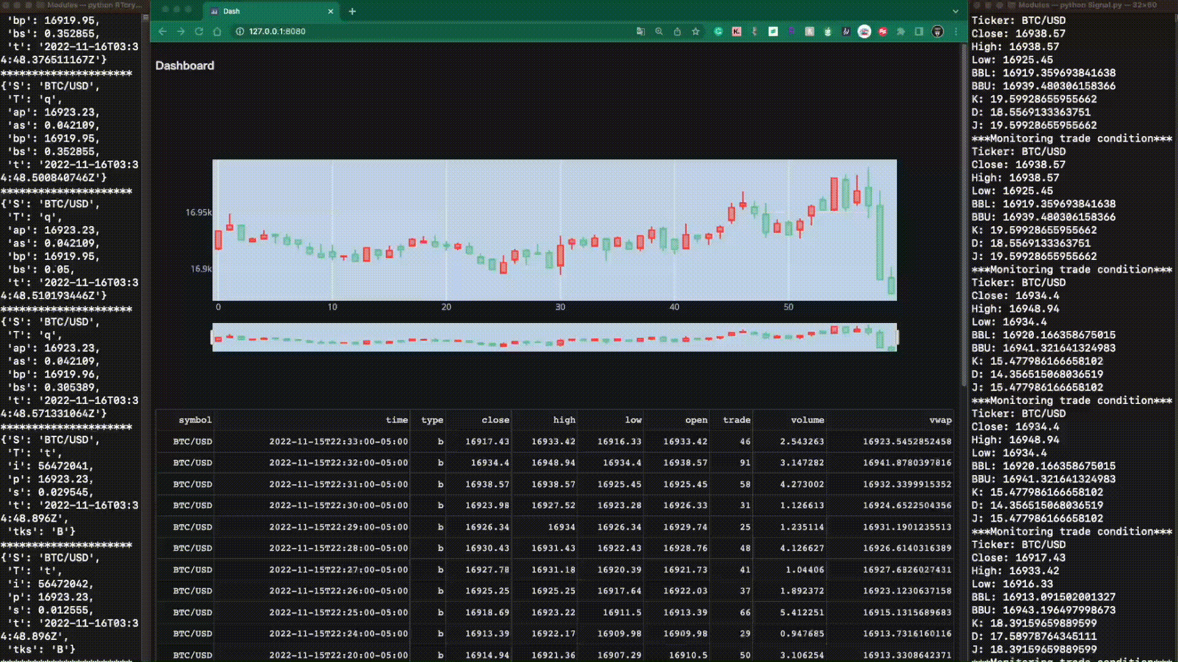
Notes:
Module right now.
Optimize Way
Cash Flow
Options Flow
Dark Pool
Example: Option FLow, DarkPool, CashFlow,whole market(VIX)

